Slide 1

Mini project : challenge Areal team sputnik
Members :
VERRIEZ CHASTANG Mathilde
DORDAIN Jean-Camille
HERBERA Mathis
Lydia ZENAIDI
Rayane DAHASSE
HUART Kevin
URL of the challenge :
https://codalab.lri.fr/competitions/399
Repo GitHub of project :
https://github.com/grpSputnik/Sputnik

Slide 2
Context and description of the problem
* 13 categories
* 9100 satellite images
* size 32*32 pixels
* 700 images per class
* 2 parts : preprocess part and row data part

Slide 3
1) The preprocessing part
2) The prediction/classifier part
3) The vizualisation part

Slide 4

1) Preprocessing
* Load and transform raw data into understandable data
* 9100 images raw
* size 32*32 pixels
* algorithm of feature selection
* PCA

Slide 5
Feature selection (before)
0 | 0 | 1
0 | 1 | 1
0 | 0 | 0
0 | 1 | 1
1 | 1 | 0
0 | 1 | 1

Slide 6
Feature selection (after)
0 | 1
1 | 1
0 | 0
1 | 1
1 | 0
1 | 1

Slide 7
2) Prediction
* Naive Bayes or Gaussian Classifier
* SVM
* Decision Tree
* Random Forest
* Nearest Neighbors

Slide 8
Statistics and preliminary results
Method | NaiveBaiyes or Gaussian Classifier | SVM | Decision Tree | Random Forest | Nearest Neighbors
Training | 0,81 | 0,81 | 0,57 | 0,64 | 0,92
CV | 0,80 | 0,79 | 0,67 | 0,63 | 0,83
Validation | 0,80 | 0,80 | 0,56 | 0,65 | 0,85
Preliminary results
Notes:
<numéro>

Slide 9
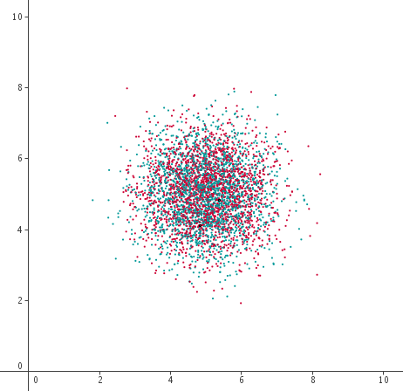
3) The visualization part
Point cloud
Source : http://calque.pagesperso-orange.fr/logiciels/graphisme/nuage.html
Notes:
<numéro>

Slide 10
Conclusion
- Best score in Codalab, which is 0.899.
- Preprocessing part really important as we need to find the best balance between loss of data and the time it is going to take for the prediction part.

